Slide 1
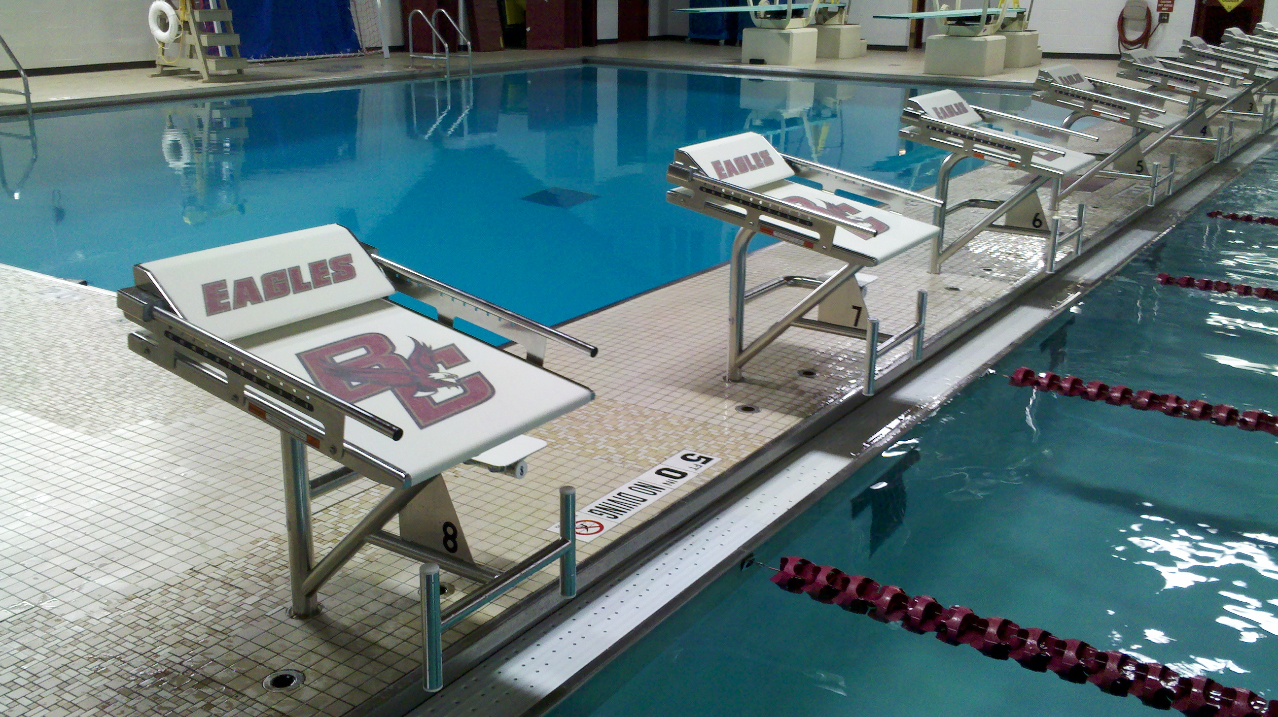

Starting Block Maintenance

Slide 2
Starting Block Maintenance
Preseason Checklist
Visual inspection of the starting blocks
  Grip is in good condition
  SS frame is free from corrosion
  Powder coating is clean
Physical Inspection
  Verify all bolts are tight, the top, step, handles, and wedge are secure
  Check wedge for smooth operation
  Any “wobble” when placed in the deck anchor

Slide 3
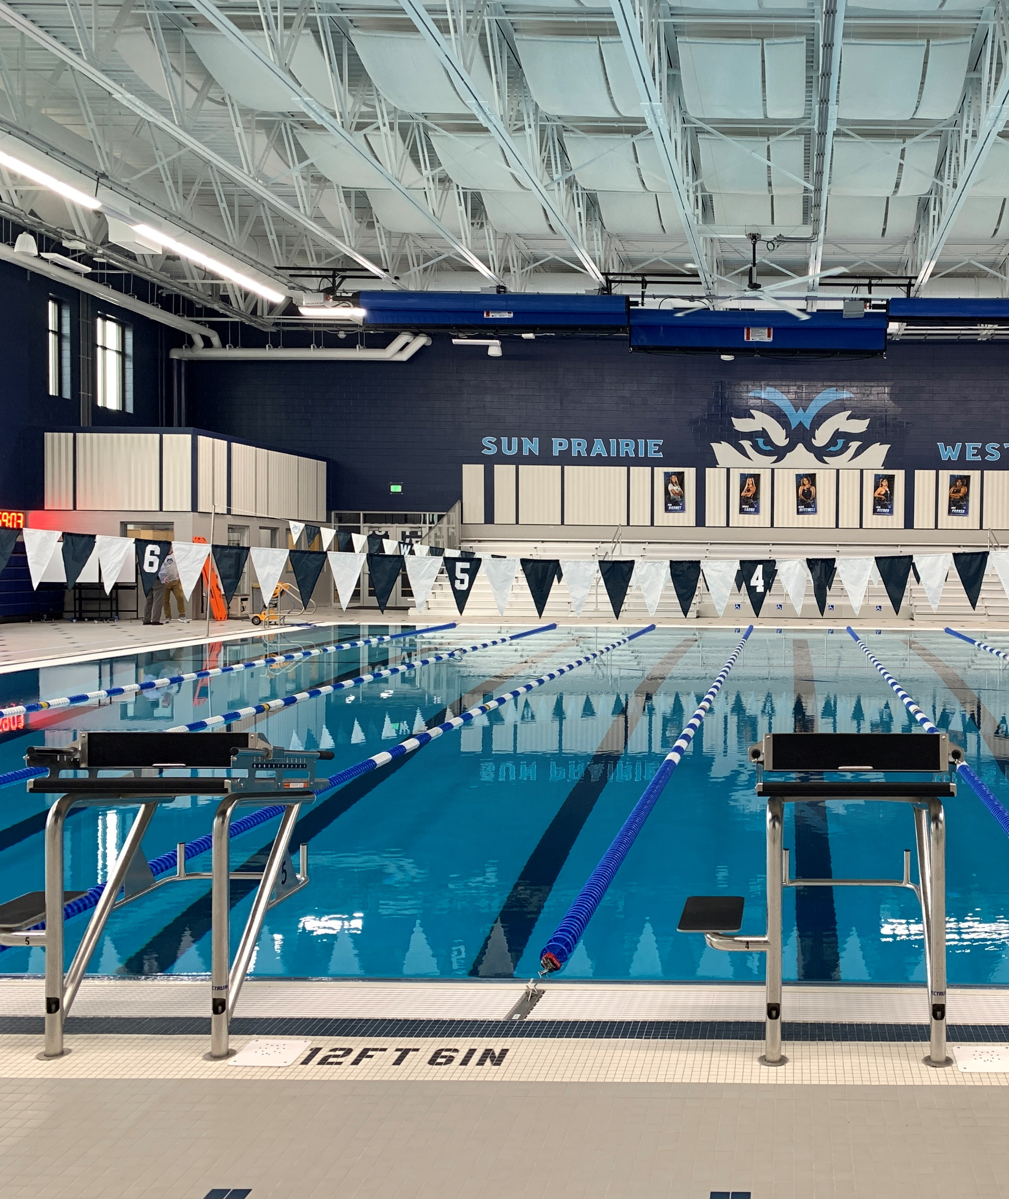
Stainless Steel
All stainless steel will rust if exposed to adverse conditions such as chlorides (in swimming pools and marine environment) and other corrosive materials.
However, proper maintenance procedures can prevent occurrence of damaging rust and correct rusting problems if it does occur.

Slide 4
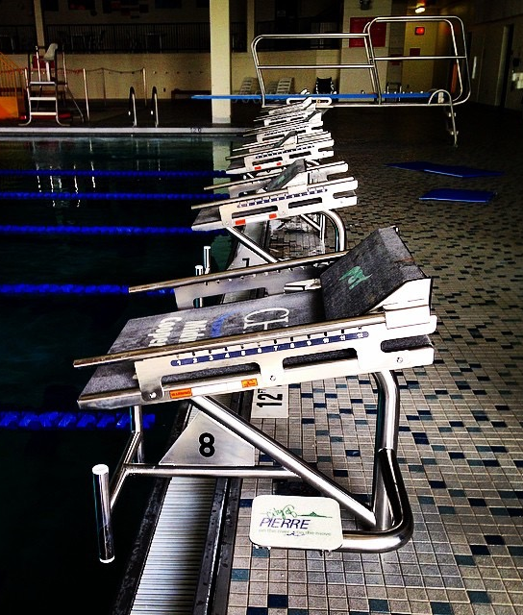
Daily rinsing with clean water is the best way to maintain the surface. This removes any chlorides that may have been splashed onto the surface in normal use. In addition, if ANY rust is visible it needs to be removed immediately, using a passivation product (Spectra-Clean System 1). This will remove the rust and re-passivate the surface.
All areas passivated also require treatment with SPECTRA SHIELD to ensure salts do find a way into the structure of the steel.

Slide 5
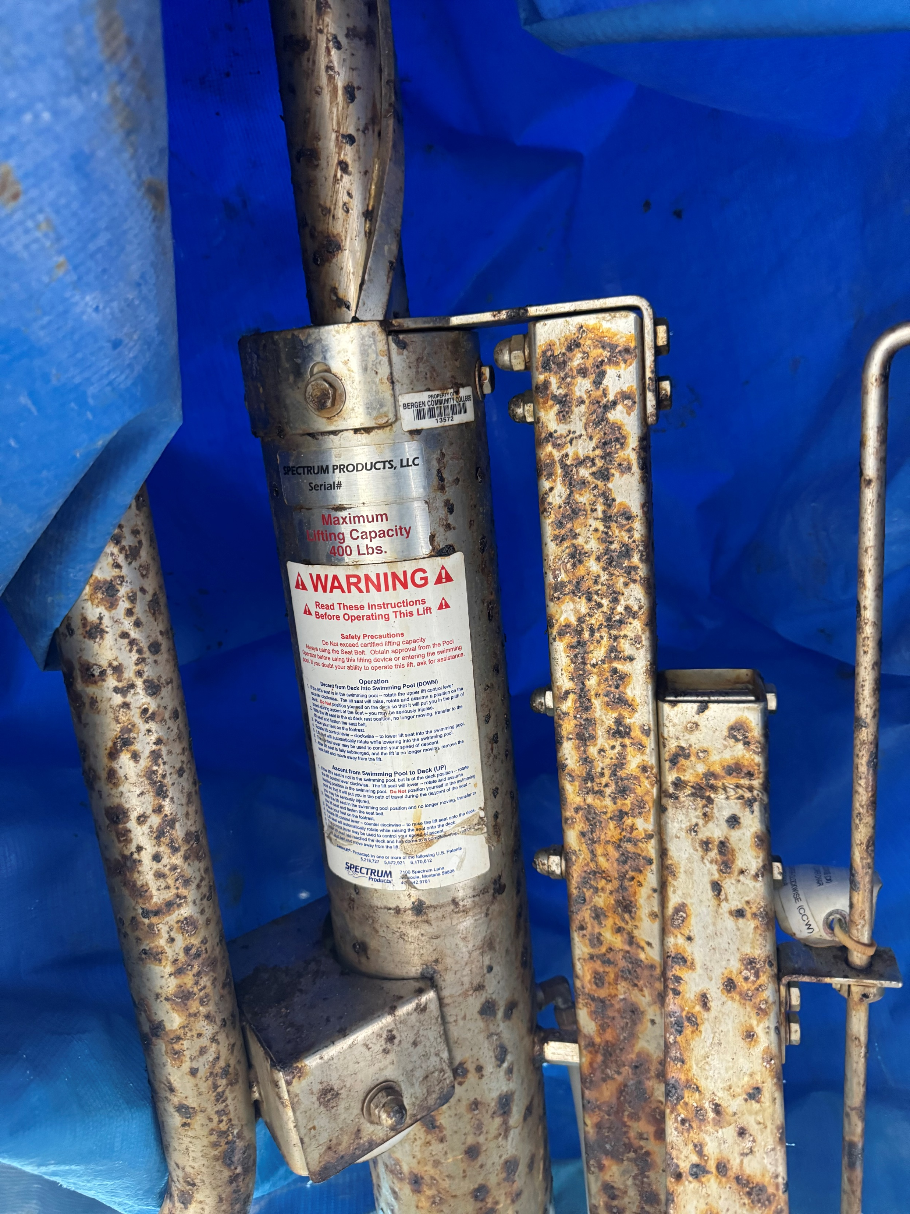
Stainless steel that has rusted severely
Once the stainless steel has rusted to the degree where corrosion is crusty that may indicate pitting. Pitting is permanent and pitted stainless requires more maintenance ongoing. But pitted or not most crusty rails can be cleaned up with an aggressive cleaning approach.

Slide 6
Stainless Steel Maintenance
The first step is to remove the rust with a Spectra-Clean System 1. Use of Non-scratching Scotchbrite® can help to remove crusty rust (maroon/blue grade).
Seal the inter-granular structure with SPECTRA SHIELD.
Do regular inspections & follow-up care to remove tarnish & lite rust as it appears.

Slide 7
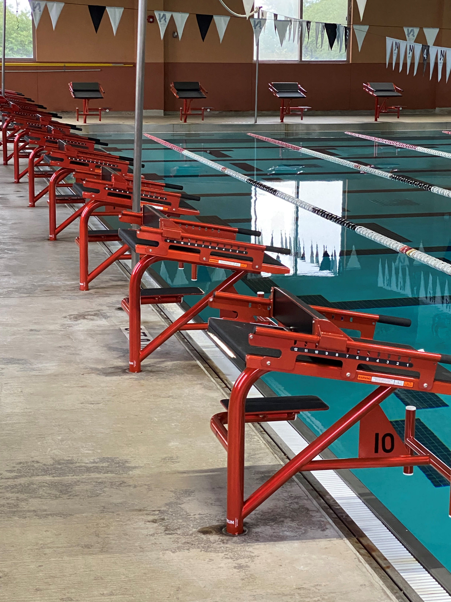
Powder Coat Maintenance
WEEKLY
Rinse with fresh tap water.
Dry with clean, soft cloth.

Slide 8
Monthly/Yearly
Use nonabrasive soap and tap water. Avoid harsh chemicals and disinfectants. Always read the label on any cleaner before applying it to the surface.
Periodically check the surface for cracks and chips. If rust is found, clean surface with a nonabrasive cleaner and contact Spectrum for a powder coat touch up kit.
After cleaning the starting block frame, you can apply car wax and buff to a shine. This will keep your frames looking new.
Apply WD-40 as necessary to the wedge/rail bracket to help ensure smooth wedge movement.

Slide 9
Jake Godinez – National Sales Manager
972.626.4761 jake.godinez@spectrumproducts.com
Torie Madgwick – West Coast Inside Sales
406.532.6357 torie.madgwick@spectrumproducts.com
Lisa Adams – Marketing Manger
800.791.9056 lisa.adams@spectrumproducts.com

